Slide 1
Wits RHI
Operation Gophelega
(Striving for good health)
Sustaining HIV/TB Epidemic Control (SHEC) in South Africa under PEPFAR
CDC-RFA-NU2GGH002381
Mamelodi Hospital profile

Slide 2
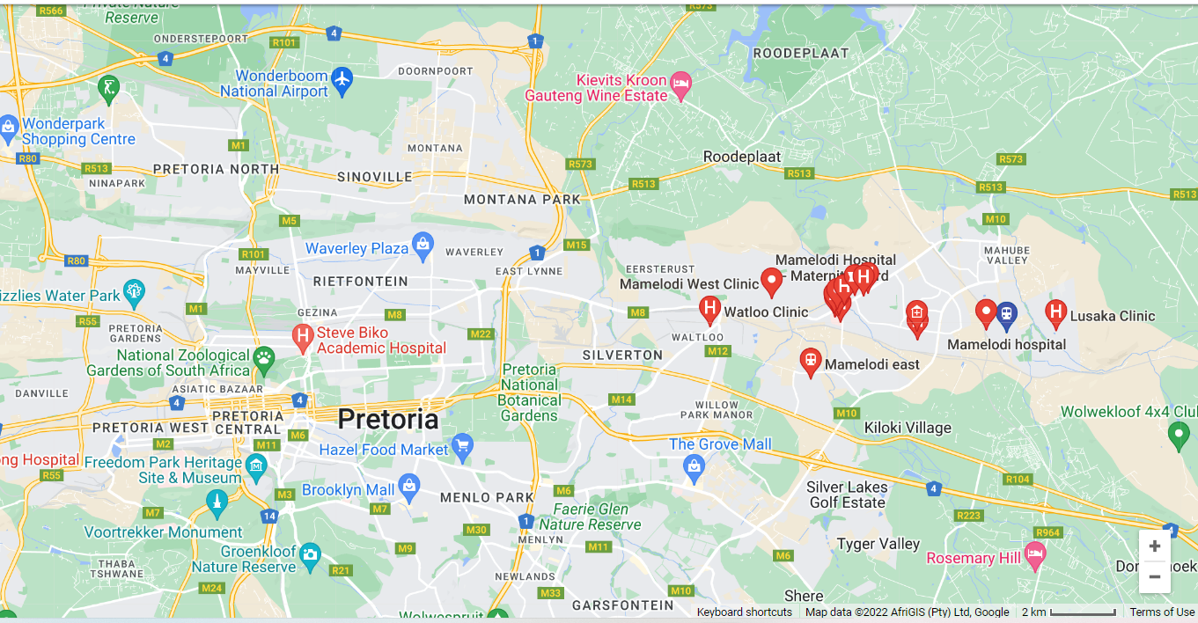
Background : Mamelodi Hospital
Mamelodi Hospital in City Tshwane, Region 6 in Mamelodi Township located on Mathane Ave. Mamelodi Hospital is situated nearby to Tshwane North College, and close to JNF Walter Sisulu Environmental Centre
HIV prevalence amongst clients tested-2.9%
TROA- 2592 as of 29 August 2022

Slide 3
Clinic Profile: Mamelodi Hospital
Services offered in the facility
Clinical Specialties in fields of Medicine, Surgery, Obstetrics and Gynaecology, Paediatrics, Psychiatry, Radiology, Emergency Medical Services, Trauma etc.
Non Communicable Disease
Clinical management of HIV/AIDS, STIs and TB
TB preventative therapy
Family planning
Cervical screening and colposcopy services
HIV and TB (including drug-resistant TB) Management for adults and children
Laboratory HIV testing, including rapid testing, HIV ELISA and PCR, Resistance testing
HTC service
Catchment areas
Mahube Valley.
Mamelodi Ext 1-22.
Mahube Valley.
East Lyne.
Silverton.
Eesterust.
Nellmapius.
Catchment population
334 577
Operating Hours:
24 hrs
Mon to Sun
Monthly Head count
19418

Slide 4
Clinic Profile: Mamelodi Hospital
1. Main Challenges for the facilities
Home delivery not promoted
Unstable patients from the wards, discharged prior ART initiation.
ART clinic not operation on weekends
2. Facilities strength
Eligible clients are decanted for CCMDD
Physical tracing (community and the facility team) and tele tracing
Support from different technical teams
Working with other stakeholders (Future families assist with tracing and right to care)
Back up generator
Tertiary institutions
Tshwane North TVET College has 6 campuses,
The University of Pretoria campus incorporated from Vista University
3. 33 Primary Schools
16 High Schools
4. X2 Police stations
5. X 17 Industries and factories
6. X5 Taxi ranks
HIV
1. TROA- 2592
2. HIV positivity rate-2.9%

Slide 5
Facility Profile: Mamelodi Hospital
Additional services offered at the facility:
There are number of programs in and around Mamelodi Hospital that are directly or indirectly supported by WRHI that could be observed during a visit, including:
HIV testing and antiretroviral (ART) therapy initiation services at wellness clinic and hospital wards
Family Care Days supported through ELMA funds
Postnatal Clubs
COVID screening in conjunction with HIV testing
Voluntary Medical Male Circumcision (VMMC) services

Slide 6
Clinic Profile: Mamelodi Hospital
Stakeholder supporting the facility
The facility is supported by stake holders, providing different levels of support
CBOs Funded by DoH Providing HTS, Index and linkage to care of all tested positive clients
IRD (Integrated…..) : offers TB services such TB screening & monitoring of TB cases
Right to Care: provides Male Medical Circumcision
Future Families: provides HTS and refer for linkage to the facility and PSS to adolescents in care at the facility

Slide 7
Staffing Profile for ART clinic (Ntshembo)
No of personnel | Category | Comments
4 (DoH) | Nurses | No wits Nurse Lead
7 (DoH) Plus 2 (Wits) | Counsellors | 1 DOH Counsellor on school leave
2 (DoH) | Admin | No Wits Admin
1 (Wits) | SIO | No DoH SIO
1 (Wits) | SIPM Wits
1 (Wits) | TN Wits
1 (Wits) | CM
TOTAL : Wits 6 DoH 11
1 PSS Mentor, 1 PSS counsellor supporting once a week, 1 Project Manager TB once a month (Wits RHI staff)

